Slide 1

CAN YOU SEE ME?
Getting to know each other

Slide 2
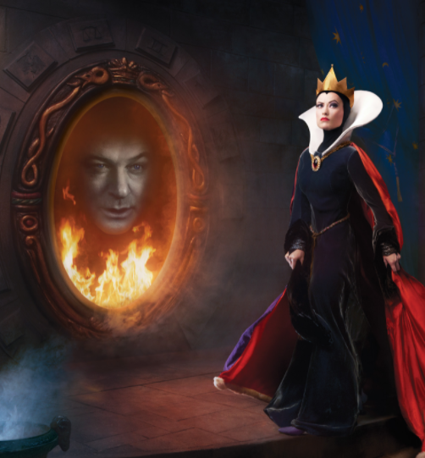
Identity
“Who am I?” is a question we all ask at some time in our lives. As we search for answers we begin to define ourselves.
How is our identity formed? To what extent are we defined by our talents and interests? by our membership in a particular ethnic group? by our social and economic class? by our religion, by the nation in which we live? How do we label ourselves and how are we labeled by others? How are our identities influenced by how we think others see us? How do our identities inform our values, ideas, and actions? In what ways might we assume different identities in different contexts? How do we manage multiple identities? Answers to these questions help us understand history, ourselves, and each other.

Slide 3
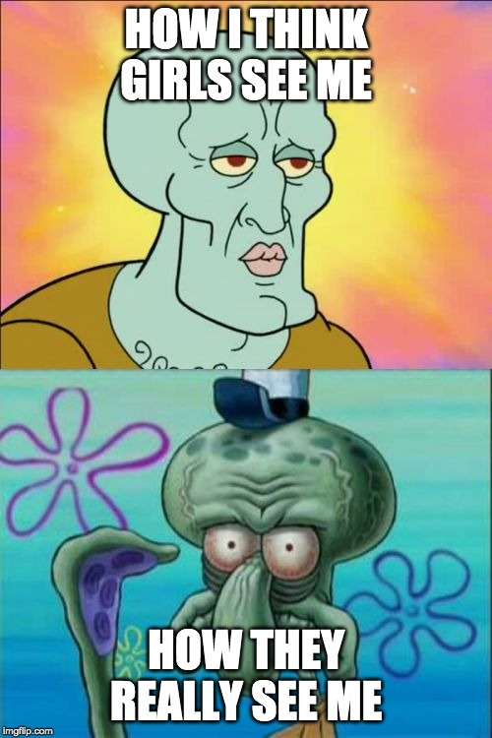
Identity Chart
Who Am I? – what things come to mind when we consider who we are?
  Role in our family
  Skills, abilities, hobbies
  Background – race, religion, nationality, hometown
  How has our view of ourselves changed over time (as we have aged and learned new skills)
  How have others influenced how we identify ourselves?
  What other questions might we consider?
You can access the chart HERE

Slide 4
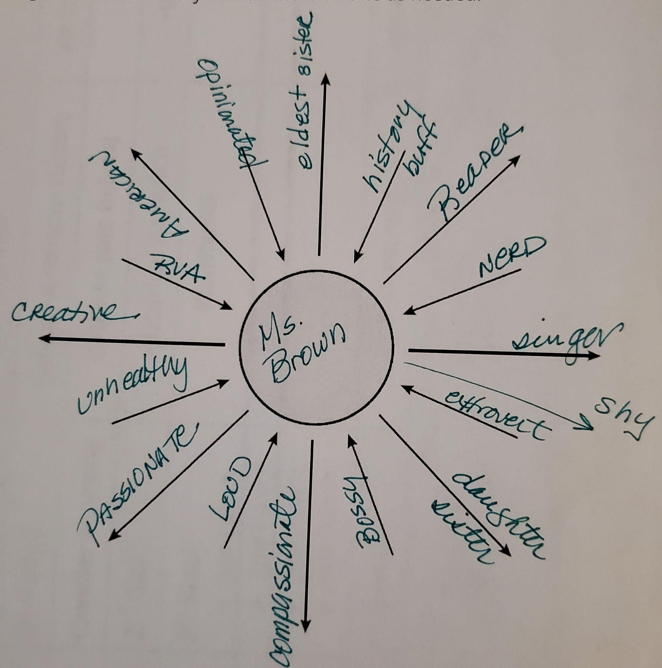
The Chart
Put your name in the circle.
Arrows pointing away from the center are factors you feel make up your identity. (How do you see yourself?)
Arrows pointing toward the center are labels or factors placed upon them from outside.

Slide 5
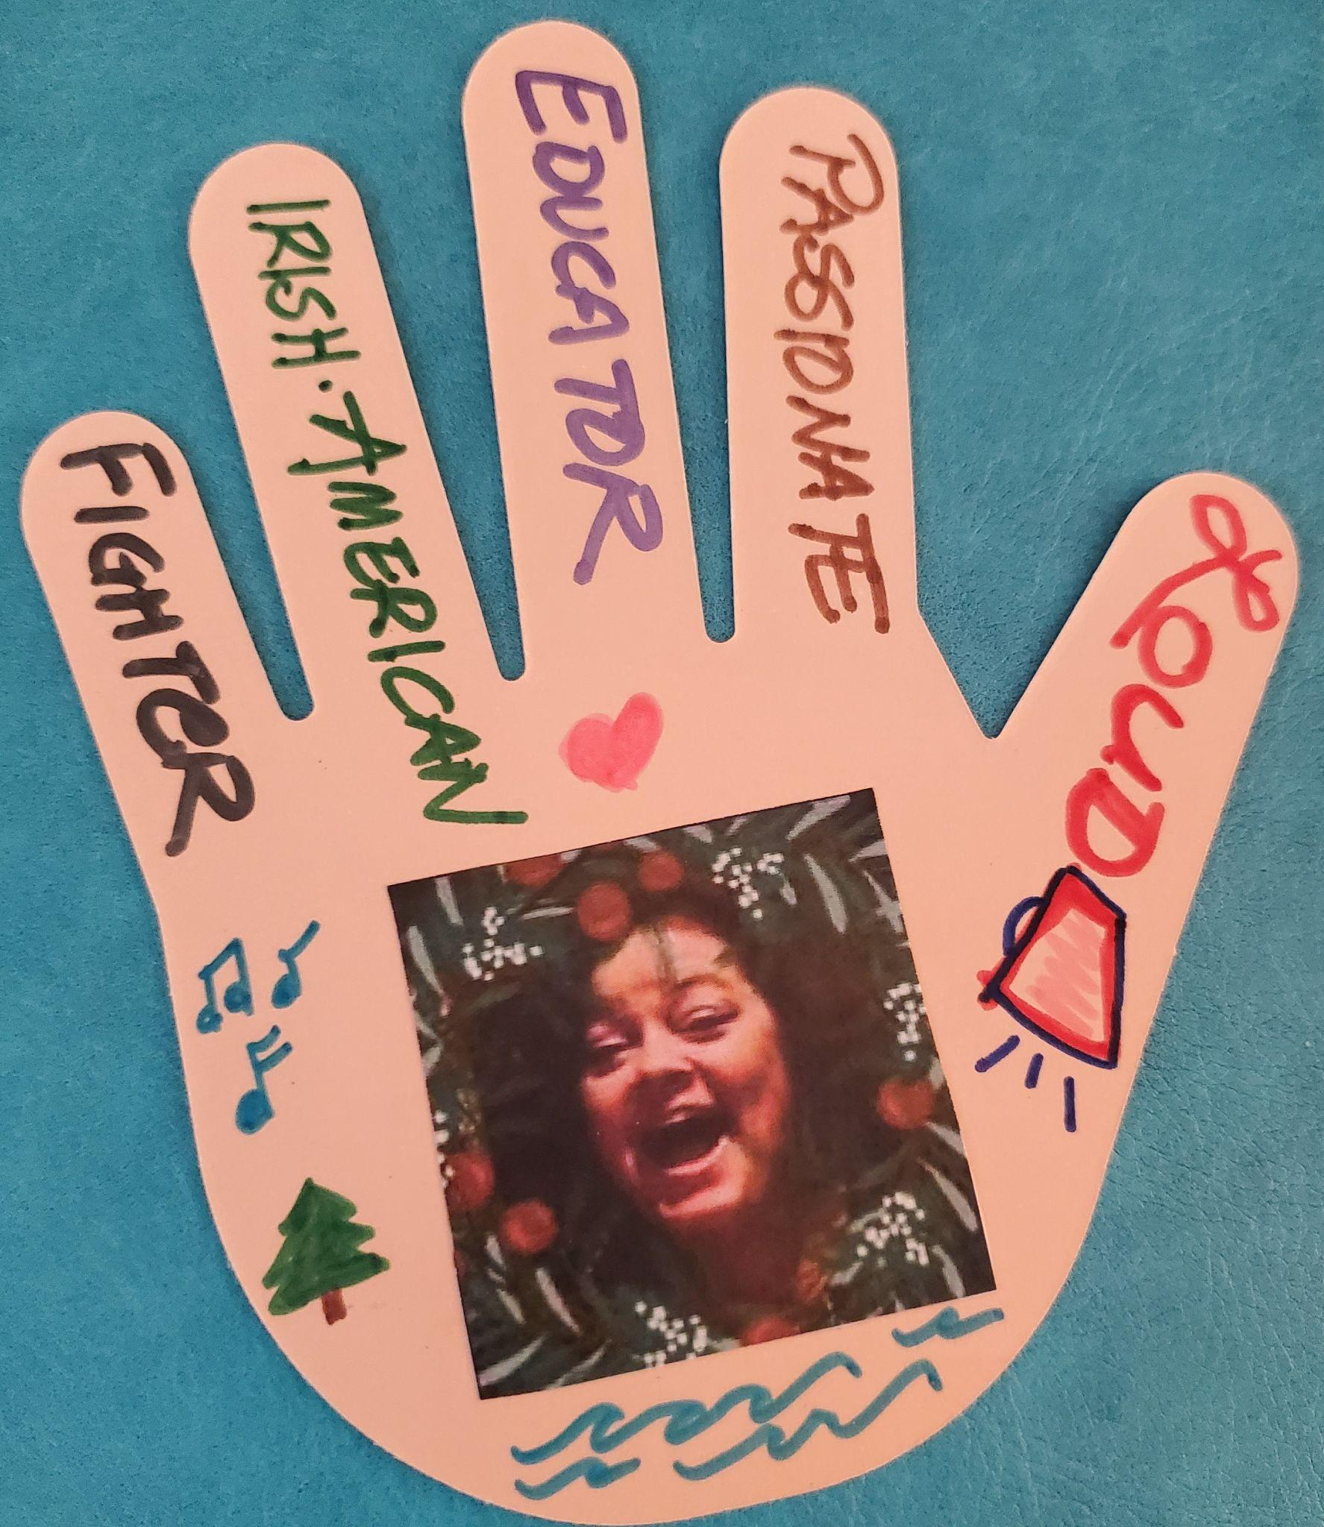
Can You See Me Wall
Identity Collage - Say HI to ME!
You will create a High Five of your identity.
Pick a hand, any hand!
Fingers: 4 ways you see yourself
Thumb: How others may see you!
You can draw, collage, use words, however you wish to show yourself.
With your names on the back, I will put these HELLOs on the board in the back.

